Slide 1

OCU MENTCARE
From
Geethika Sreya
Jahnavi
Hanumantha Rao

Slide 2
Abstract of the Project
The OCU Clinics MentCare project is a web platform designed to make it easier for patients to book appointments with doctors at OCU Clinics. It uses HTML, CSS, and JavaScript to create a user-friendly system that lets patients quickly choose doctors and pick available time slots. This helps reduce waiting times and the need for manual scheduling, making it easy for patients to get the care they need.
The main goal is to provide a smooth process where patients can see which doctors are available, pick a suitable time, and confirm their appointments with just a few clicks. The system is also responsive, meaning it works well on laptops, tablets, and smartphones. Overall, it improves the patient experience and helps clinics manage schedules more efficiently.

Slide 3
Project Objectives
Simplify Appointment Booking: Create an easy-to-use system for patients to book doctor appointments online.
Reduce Manual Work: Automate the scheduling process to minimize the need for manual appointment handling.
Enhance Patient Experience: Provide a user-friendly platform that makes it simple for patients to find available doctors and choose preferred time slots.
Improve Efficiency: Ensure quick and efficient appointment management for both patients and clinic staff.
Responsive Design: Develop a platform that works seamlessly on laptops, tablets, and smartphones.

Slide 4
Software Requirements
Frontend Technologies: HTML, CSS, JavaScript for building the user interface.
Browser Compatibility: The application should be compatible with all major browsers (Chrome, Firefox, Safari, Edge).
Version Control: Git for code management and collaboration.

Slide 5
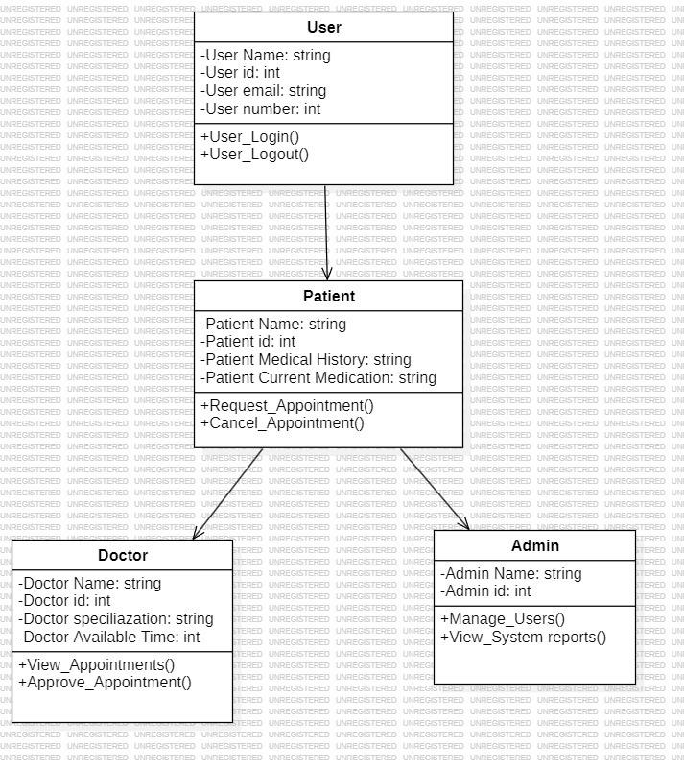
UML Diagram
Class Diagram 1:

Slide 6
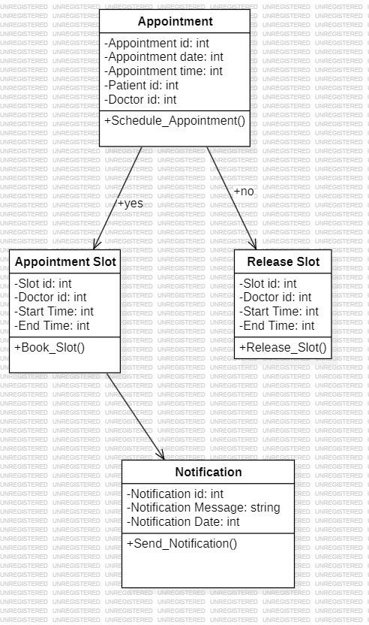
Class Diagram 2:

Slide 7
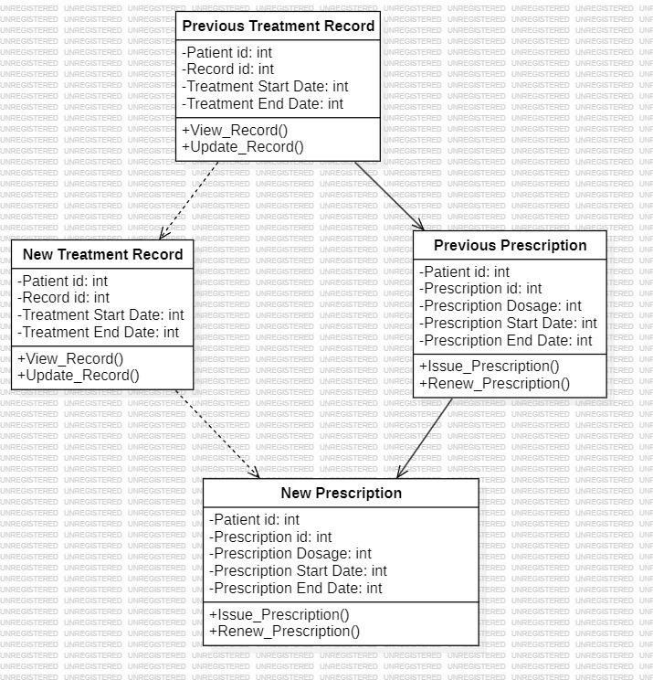
Class Diagram 3:

Slide 8
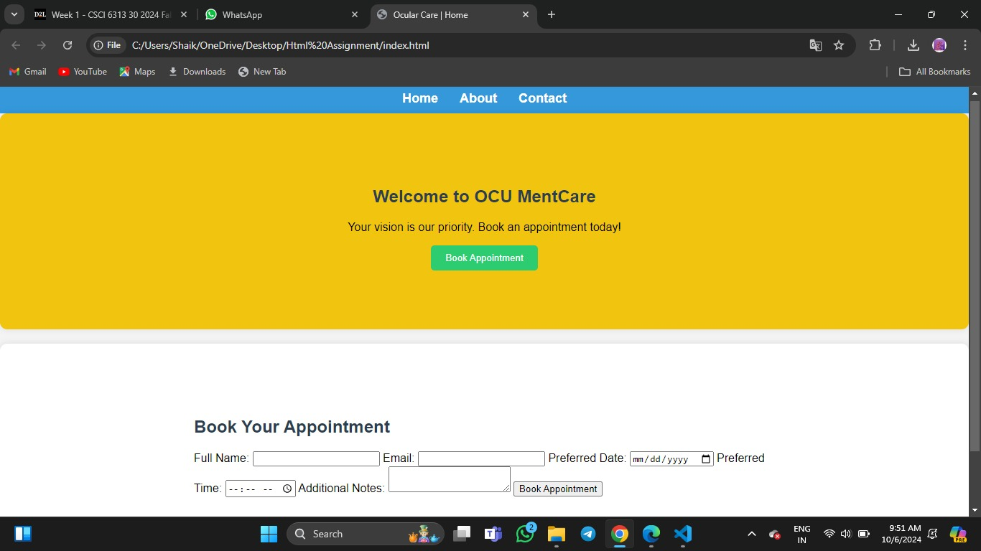
Outputs of the Project
Patients can book, reschedule, and view their appointments.

Slide 9
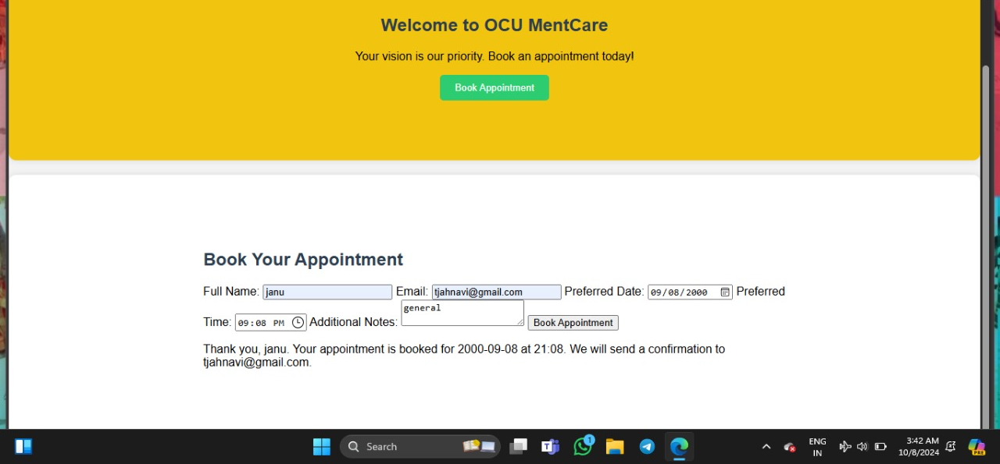
Appointment confirmations are displayed.

Slide 10
Conclusion
The OCU Clinics MentCare project successfully addresses the need for a streamlined appointment booking system at OCU Clinics. Using HTML, CSS, and JavaScript, the platform provides an intuitive interface that allows patients to schedule, reschedule, and manage their doctor appointments with ease. By automating the appointment process, the system reduces the workload for clinic staff and minimizes manual errors, leading to a more efficient healthcare management solution.
Overall, the project achieves its primary goals of simplifying patient-doctor interactions, improving the user experience, and ensuring that patients can conveniently access healthcare services. Future enhancements, such as incorporating automated reminders and integrating telehealth options, can further improve the platform’s usability and impact on patient care.

Slide 11
THANK YOU

